Slide 1
HUMAN DETECTION IN NATURAL DISASTERS USING YOLO v3
Developed By:
Sheetal P
Meghana H D
Vidyashree M B
Smruthi S Kiran

Slide 2
TABLE OF CONTENTS
Introduction
Purpose
Block Diagram
Flow Chart
Software Designing
Result
Advantages and Disadvantages
Conclusion

Slide 3
INTRODUCTION
A natural disaster is a major adverse event resulting from natural processes of the Earth; examples are floods, hurricanes, tornadoes, volcanic eruptions, earthquakes, tsunamis, and other geologic processes.
After Natural disaster happened the rescue team will go to that place to help the people. But during such kind of disaster there will be places where humans cannot go and identify people to deliver help, by the time they identify them the person might lose his life.
To avoid this scenario there should be a device which can cover the areas where a human cannot enter which helps rescue teams to deliver help faster.
We are building a Device which will have a camera that will be in continuous video streaming, it will detect the human being with the help of YOLO object detection algorithm.
If it detects the person then it will send the image to admin department.

Slide 4
PURPOSE
Natural Disasters happen almost every year in some part of the world so we have to detect how the places and the human beings living in that place and surroundings have been affected. Yolo algorithm is used for object detection, which helps for instant identification of humans struck in those disasters. By which many lives can be saved on time. Object detection is a field of Computer Vision and Image Processing that deals with detecting instances of various classes of objects in a digitally captured Image or Video.

Slide 5
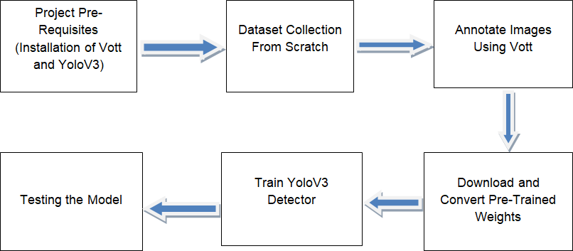
BLOCK DIAGRAM

Slide 6
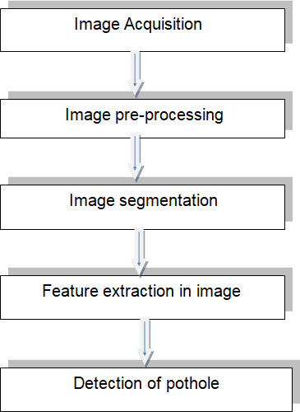
FLOW CHART

Slide 7
SOFTWARE DESIGNING
Microsoft VOTT
Machine Learning Algorithms
Python Programming Language
YOLOv3structure
With multiple images being captured, it becomes essential that the object detection model detects humans in the least amount of time. YOLOv3 (You Only Look Once ver.3) improves operation speed which meets real time requirements for detection. Darknet is a framework for YOLO implemented using C/CUDA. To make the object detection model mobile friendly, the model is converted to a TensorFlow lite model, which compresses the neurons in the neural network. This will make the model run eﬃciently in the mobile device.

Slide 8
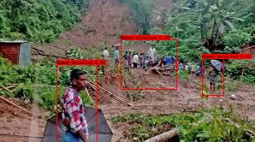
RESULT
Final output image which shows percentage of human presence

Slide 9
RESULT
Various deep convolutional networks with different architectures and improvements in the accuracy and speed as a result have been proposed for image classiﬁcation. The classiﬁcation models are evaluated in terms of the number of ﬂoating point operations, depth, number of parameters, sparsity inﬂuence the computational speed and memory requirement. DarkNet-19 and DarkNet-53 are fully convolutional networks, proposed with YOLOv2 and YOLOv3 respectively and have achieved reasonable classiﬁcation accuracy and speed. We have evaluated these backbone networks for their accuracy in detecting the humans. We trained and tested our algorithms on the complete data set to start with. Later we randomly separated the data set into training data and test data so that we had samples from each class. The model was able to classify more than 80% of the images. The testing accuracy of the system is about 80%. Depending on the classiﬁcation, the message and details will be sent over to produce sound or alarm to the person who hands over that department. Thus effectively detecting the humans.

Slide 10
ADVANTAGES
Except from the improvements in precision observed in the classiﬁcation/prediction problems at the surveyed works, there are some other important advantages of using YOLO image processing. Previously, traditional approaches for image classiﬁcation tasks were based on hand-engineered features, whose performance and accuracy greatly affected the overall results. Feature engineering (FE) is a complex, time-consuming process which needs to be altered whenever the problem or the data set changes. Thus, FE constitutes an expensive effort that depends on experts’ knowledge and does not generalize well.
It seems to generalize well and they are quite robust even under challenging conditions such as illumination, complex background, size and orientation of the images, and different resolution. They can take preventive measures.

Slide 11
DISADVANTAGES
The main disadvantage is that sometimes it can take much longer to train. However, after training, their testing time eﬃciency is much faster than other methods
Other disadvantages include problems that might occur when using pre-trained models on similar and smaller data sets, optimization issues because of the models’ complexity, as well as hardware restrictions.

Slide 12
CONCLUSION
Natural disasters reflect people's vulnerability or their susceptibility to be affected when confronted with floods, cyclones, volcanic eruptions, landslides.The paper showcases our work performed to train an object detection model capable of detecting the humans in natural disasters. The collection of images for dataset to train the model consisting images of natural disasters like floods,uraicane, earthquake .Tiny YOLOv3, a CNN which is capable to identify the humans in natural disasters, which helps to identify humans who are in danger as early as possible. These capacities have to be utilized to reduce the risk of disaster.

